Slide 1

Introduction
M SHUJAAT ABID
MSCS:
Virtual University of Pakistan (Ongoing)
MCS:
Virtual University of Pakistan (Gold Medalist)
Research Area:
Data Science, Machine Learning & Deep Learning

Slide 2
Outline
Topic
Significance of Transportation System
Challenges
Road Accidents Analysis
ML Techniques and Algorithms
Literature Review
Innovation of the Current Study
Dataset
Research Questions
Research Objectives
Framework
Methodology
References

Slide 3
Topic
ROAD ACCIDENT ANALYSIS: PREDICTING AND EXPLORING INJURY SEVERITY USING MACHINE LEARNING PARADIGMS

Slide 4
Significance of Transportation System
In today's fast-paced world, roads, transportation systems and vehicles play a crucial role in connecting people, transferring goods, and services across cities, countries, and even continents.
Socio-economic and environmental impacts on industries, governments, and societies at large
Tremendous increase in the number of road vehicles over the years

Slide 5
Challenges
Along with the benefits of road infrastructure come risks and challenges
Transportation system should be
Efficient
Secure
Sustainable

Slide 6
Road Accidents Analysis
According to WHO reports:
Approximately 1.3 million people lose their lives every year in road traffic collisions
Around 20-50 million people suffer non-fatal injuries with disabilities
Around 270,000 pedestrians gets fatal injuries
Many pedestrians suffer from major injuries that leads to disabilities
Motivation:
These figures highlight the urgent need for comprehensive road safety strategies that prioritize the protection of vulnerable road users.

Slide 7
ML Techniques and Algorithms
Association Rule
We will find the factors that leads to fatal or major injuries with the help of association rule mining technique
We will develop classifier models using different well-known algorithms and techniques
Compare the performance of these models
Select the best performing model for deployment

Slide 8
Literature Review
Sr No | Title | Citation | Objective | Strengths | Weaknesses | ML Technique | Performance
1 | Fatality Prediction for Motor Vehicle Collisions: Mining Big Data Using Deep Learning and Ensemble Methods | Emu, M., Kamal, F. B., Choudhury, S., & Rahman, Q. A. (2022). Fatality prediction for motor vehicle collisions: mining Big Data using deep learning and ensemble methods. IEEE Open Journal of Intelligent Transportation Systems, 3, 199-209. | Developing a model that predicts whether the outcome of a collision will be fatal or non-fatal. | Sufficient dataset used for training and necessary pre-processing has been done | Missing some important features (related to driver behavior and car condition) More models can be trained based on other classifiers Performance can be further improved by tuning-up the models | Random Forests, K Nearest Neighbor, SVM, Convolutional Neural Networks | Accuracy of all these ranges from 69.38% to 75.56%. CNN is best with Accuracy= 75.56% Precision = 75.74% Recall = 75.45%
2 | A Framework for Analyzing Road Accidents Using Machine Learning Paradigms | Yadav, J., Batra, K., & Goel, A. K. (2021, August). A Framework for Analyzing Road Accidents Using Machine Learning Paradigms. In Journal of Physics: Conference Series (Vol. 1950, No. 1, p. 012072). IOP Publishing. | Identifying factors that have an impact on road accidents. | An in-depth analysis of the dataset has been shown in the paper | Its results are not very significant as it is unable to reveal major facts Performance measures are not discussed explicitly for all the algorithms | Supervised: AdaBoost Naïve Bayes K-Nearest Neighbour (KNN) Decision tree Unsupervised: K-means clustering algorithm CART, ROC value | 81.5% accuracy with CART algo AdaBoost achieves best performance.

Slide 9
Literature Review
Sr No | Title | Citation | Objective | Strengths | Weaknesses | ML Technique | Performance
3 | PREDICTION OF FATAL AND MAJOR INJURIES OF DRIVERS, CYCLISTS, AND PEDESTRIANS IN COLLISIONS | Shanshal, D., Babaoglu, C., & Başar, A. (2020). Prediction of Fatal and Major Injury of Drivers, Cyclists, and Pedestrians in Collisions. Promet-Traffic&Transportation, 32(1), 39-53. | Building a prediction model that predicts the fatal accident and serious injuries in traffic crashes. | An in-depth analysis of the dataset is provided using both association rules and predictive models Performance of predictor mode in satisfactory | Blank or missing values are not handled properly Does not provide a direct performance comparison of the developed model | Data mining through Association rules and Classification algo: Random Forest (RF), Lasso regression (LR) | 80% accuracy of random forest for drivers and ped and 89% accuracy for cyclist Accuracy, sensitivity, specificity
4 | An Alternative Method for Traffic Accident Severity Prediction: Using Deep Forests Algorithm | Gan, J., Li, L., Zhang, D., Yi, Z., & Xiang, Q. (2020). An alternative method for traffic accident severity prediction: using deep forests algorithm. Journal of advanced transportation, 2020, 1-13. | Developing a model that will predict the seriousness of traffic collisions based on Deep Forest algorithm. | Strong analysis and data preprocessing techniques have been used to ensure the quality of the data The developed model has significant accuracy and reliable | Limited number of features are employed in the study | Deep Forest algorithm | Accuracy = 90.69% Recall = 0.92 False alarm rate = 0.09 F1 score = 0.91 ROC = 0.93

Slide 10
Literature Review
Significant amount of work has been done in the field of accident data mining, particularly in the domain of prediction models
These studies focuses only on one domain from the followings
Building the prediction model
Finding the factors that involve traffic accidents

Slide 11
Innovation of the Current Study
The study focuses on:
Factors that contributes to fatal or major injury
Statistical, predictive and descriptive analysis of dataset
Finding the hidden patterns
Extracting rules
Developing predictor model
Suggestions and recommendations to ensure the road safety

Slide 12
Dataset
Killed or Seriously Injured Dataset:
The KSI (Killed or Seriously Injured) dataset provided by the Toronto Police Services
It contains all the collisions record from 2006 to 2022 in Toronto
Contains detailed information and the characteristics of collisions
Contains demographic data, collision location, date and time, and other factors such as road surface condition and visibility etc. that may contribute to the risk of injury

Slide 13
Research Questions
Q1: What will be the estimated injury severity level of vulnerable road user in road accidents?
Q2: What are the underlying hidden factors that contribute to fatal or major injuries?

Slide 14
Research Objectives
To find out the factors that are more involved in collisions using association rule mining.
To build a prediction model that will predict the injury severity by using the different machine learning algorithms.
Evaluating the performance of these prediction models.

Slide 15
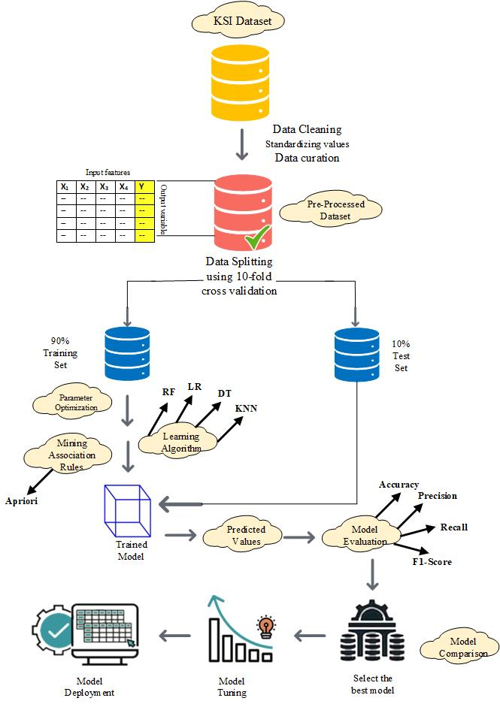
Framework

Slide 16
Methodology
The proposed methodology for this study has been divided into six steps as follows:
The first step is of data collection, we will obtain Killed or Seriously Injured (KSI) dataset that is freely available by the Toronto Police Services on public safety data portal (https://data.torontopolice.on.ca/).
After collecting data, the second step is the data pre-processing in which techniques such as data cleaning, removing the null values, standardizing the values of certain attributes including date and time, and lastly the techniques to handle the class imbalance issue are applied.
The third step is of feature selection, it consists of selecting the best features that can be used in our machine learning model for predicting the rules.

Slide 17
Methodology
The fourth step is of extracting rules, we will use Python for finding hidden patterns and creating association rules.
After getting rules, we will train our model using different machine learning algorithms and then evaluates their performances in order to get the best model.
In the last stage, we will tune-up our developed model to further enhance our model and then deploy it.

Slide 18
References
[1] Emu, M., Kamal, F. B., Choudhury, S., & Rahman, Q. A. (2022). Fatality prediction for motor vehicle collisions: mining Big Data using deep learning and ensemble methods. IEEE Open Journal of Intelligent Transportation Systems, 3, 199-209.
[2] Yadav, J., Batra, K., & Goel, A. K. (2021, August). A Framework for Analyzing Road Accidents Using Machine Learning Paradigms. In Journal of Physics: Conference Series (Vol. 1950, No. 1, p. 012072). IOP Publishing.
[3] Shanshal, D., Babaoglu, C., & Başar, A. (2020). Prediction of Fatal and Major Injury of Drivers, Cyclists, and Pedestrians in Collisions. Promet-Traffic&Transportation, 32(1), 39-53.
[4] Gan, J., Li, L., Zhang, D., Yi, Z., & Xiang, Q. (2020). An alternative method for traffic accident severity prediction: using deep forests algorithm. Journal of advanced transportation, 2020, 1-13.
[5] Hébert, A., Guédon, T., Glatard, T., & Jaumard, B. (2019, December). High-resolution road vehicle collision prediction for the city of montreal. In 2019 IEEE International Conference on Big Data (Big Data) (pp. 1804-1813). IEEE.

Slide 19
References
[6] Labib, M. F., Rifat, A. S., Hossain, M. M., Das, A. K., & Nawrine, F. (2019, June). Road accident analysis and prediction of accident severity by using machine learning in Bangladesh. In 2019 7th international conference on smart computing & communications (ICSCC) (pp. 1-5). IEEE.
[7] Parathasarathy, G., Soumya, T. R., Das, Y. J., Saravanakumar, J., & Merjora, A. A. (2019, February). Using hybrid data mining algorithm for analysing road accidents data set. In 2019 3rd International Conference on Computing and Communications Technologies (ICCCT) (pp. 7-13). IEEE.
[8] AlMamlook, R. E., Kwayu, K. M., Alkasisbeh, M. R., & Frefer, A. A. (2019, April). Comparison of machine learning algorithms for predicting traffic accident severity. In 2019 IEEE Jordan international joint conference on electrical engineering and information technology (JEEIT) (pp. 272-276). IEEE.
[9] Alam, Z. (2018). Improving Road Safety in India Using Data Mining Techniques. In Data Science and Analytics: 4th International Conference on Recent Developments in Science, Engineering and Technology, REDSET 2017, Gurgaon, India, October 13-14, 2017, Revised Selected Papers 4 (pp. 187-194). Springer Singapore.

Slide 20

Thank You

